Slide 1
BZ350 Final Recitation
T.A. info:
Chris deRoux (day-ROO)
Any/all pronouns
Chris.deRoux@colostate.edu
Office Hours: Every Friday 10AM-12PM in Bio 355
Itinerary:
Announcements
Genetics in the News
GAL Review
Exam Review

Slide 2
Announcements
Problem Set 14: Worth no points, but very similar questions may be on the final.
Exam 4 / Final: When I receive the exam from Erik, I will email out a curated study guide and make studying recommendations.
Course Surveys: PLEASE fill these out. Be honest. Don’t worry about your teachers’ career development. The admins need to be told by you, the customers, not to pull this again.

Slide 3
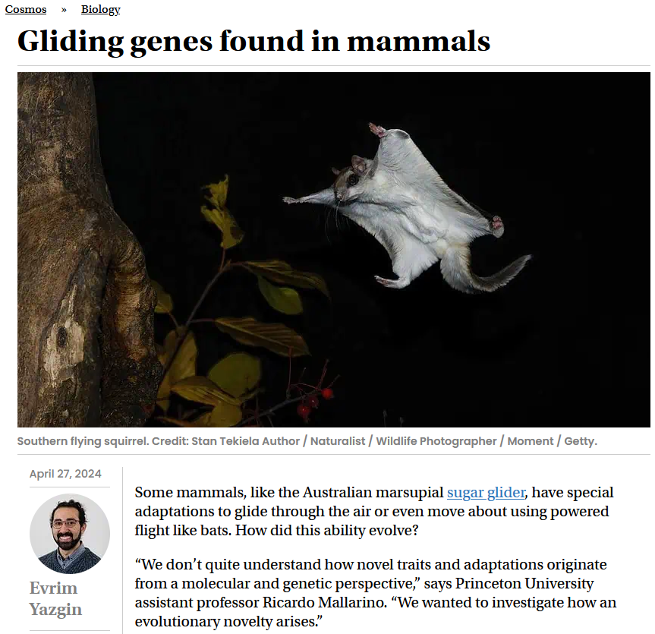

Slide 4
Translation
Genetic code
Frameshift, missense, nonsense mutation
Initiation codon, Start codon
Termination codons or stop codon
tRNA structure (anticodon, charged tRNA, wobble base)
Initiator tRNA (fMet)
Aminoacyl site (A site)
Peptidyl site (P site) and Peptidyl transferase
Exit site (E site)
Peptide bond
IFs and eIFs
EFs and eIFs
Release factors
Reading frame
Shine-Dalgarno sequence, 5’ cap
Wobble rules
Antibiotics (bacterial ribosome disrupting)
RNA interference (RNAi)
Drosha, RISC, pri-miRNA, and miRNA
Dicer, siRNA
Piwi, piRNA
Bacterial regulation
Transcriptional control
Post-transcriptional control
Lac and Trp operons
Inducible vs constitutive expression
Inducers, effectors, and corepressors
Allosteric regulation
Cis-acting vs trans-acting regulators
LacI, promoter, operator, and CAP
Beta-galactosidase - LacZ
Permease – LacY
Polycistronic mRNA
X-gal, reporter genes, selectable marker
TrpR, promoter, operator, and attenuator
Riboswitches (TrpL mRNA, aptamers)
DNA Modification/Sequencing
Cloning
Vectors (restriction site, ori, reporter, gene)
Restriction endonucleases
Blunt ends
Sticky ends
PCR (primers, use in sequencing)
Sanger sequencing
ddNTPs
Illumina sequencing
Oxford nanopore
Eukaryotic regulation
Enhancers, insulators, repressors
Regulatory transcription factors
Helix-turn-helix, Helix-loop-helix, leucine zipper, zinc finger TFs
TATA box and TATA binding protein (TBP)
Activator proteins
DNA binding domain
Transcription activation domain
Mediator proteins
Repressor proteins
Quenching, heterodimerization, chromatin remodeling
Ligand binding domain
Difference between regulatory sequences and regulatory proteins
GAL topologically associating domain
GAL1 and GAL3
GAL4and GAL80
Chromatin
Histones, H2A/B, H3, H4, nucleosomes
Histone tail modification (acetylation and methylation)
Chromatin remodeling
Basal, high, and no expression
Promoter-bound nucleosomes
Genomic imprinting and silencing

Slide 5
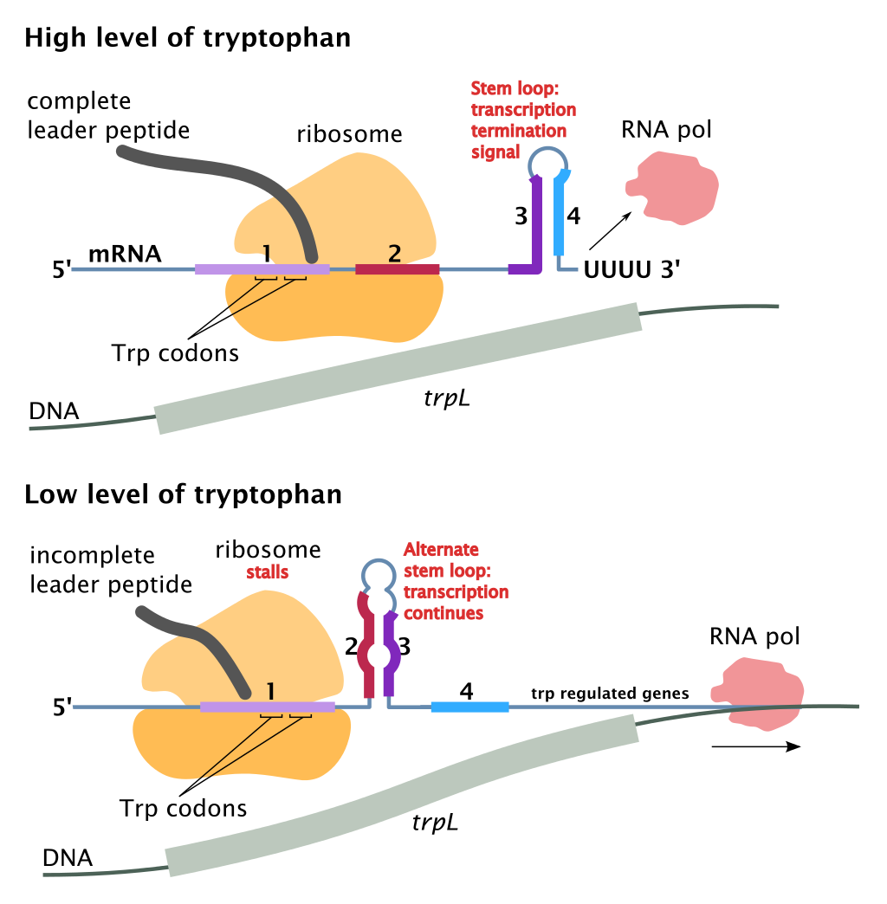
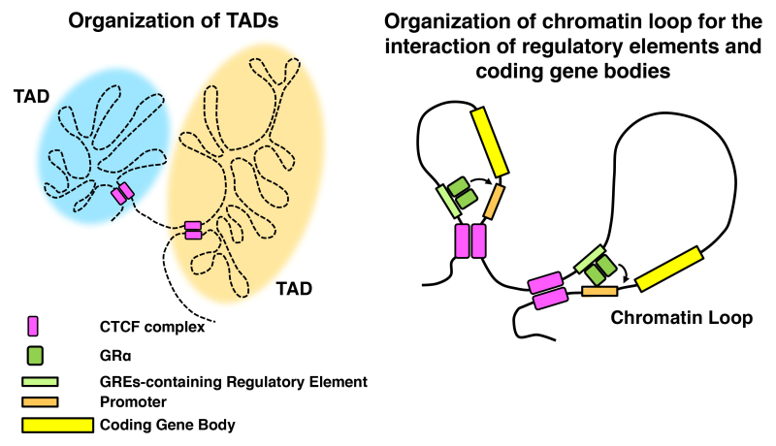
Some nice visualizations of TrpL mRNA attenuation and chromatin looping. Note CTCF proteins bound to the insulator sequences at loop boundaries. You may remember CTCF from the human Igf2.
If CTCF can’t bind to the insulator, it can’t keep apart the loop containing insulin-like growth factor 2 and the loop containing an enhancer for Igf2.
Eukaryotes can flip insulators on and off!

